Slide 1
CIND 820 Final Project Ryan Boyd 501072988
LiDAR Point Cloud Object Extraction

Slide 2
Introduction: Project Goal and Research Question
Research Question:
Can unique objects or features be distinguished from lidar point cloud data by using sci-kit learn clustering workflows?
Project Goals:
Distinguish individual features from lidar point cloud
Use clustering algorithms to group by proximity, height, surface reflectance
Improve provided classification of ground points

Slide 3
Tools
Python
Jupyter notebooks
Pandas
Sci-kit learn
Laspy
Matplotlib
Python Image Library (PIL/pillow)
QGIS
Clipping DEM, Imagery
3D Visualization

Slide 4
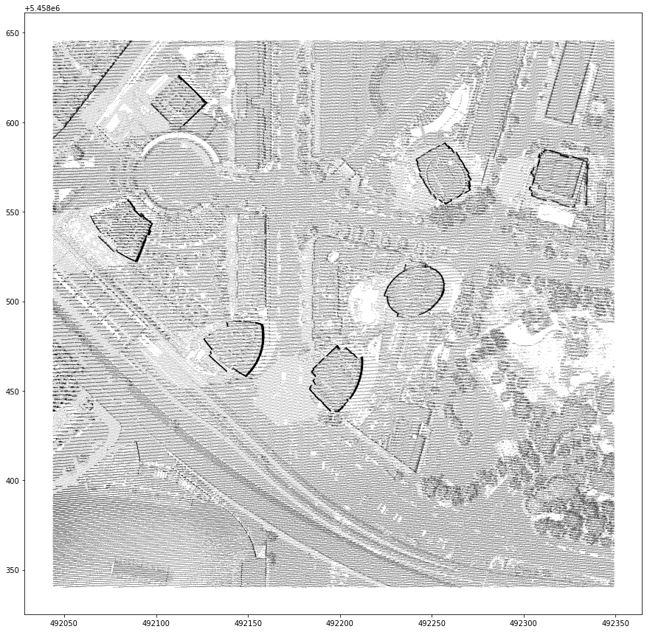
LiDAR LAS Data Point Cloud
798,900 total points
70,247 classified ground
728,653 unclassified
Attributes:
X
Y
Z
Intensity
Classification
Return Number
Return Count

Slide 5
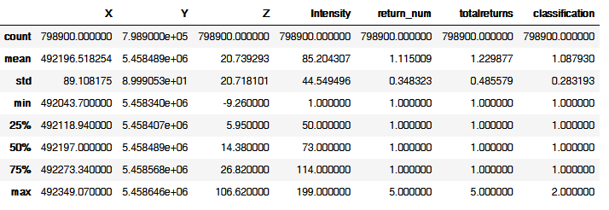
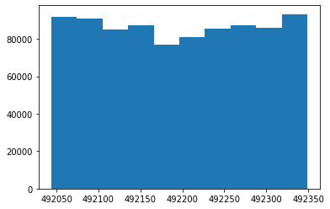
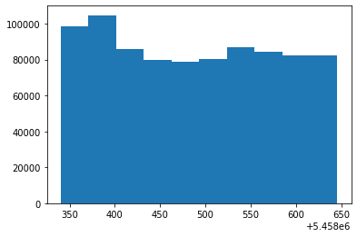
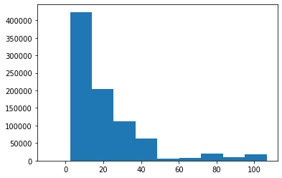
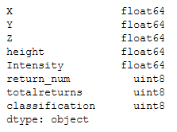
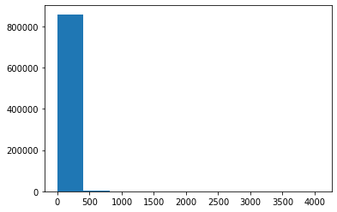
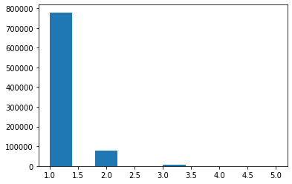
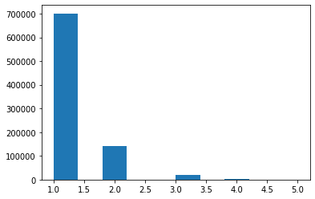
Descriptive Statistics

Slide 6
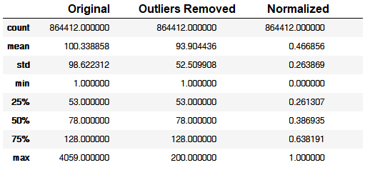
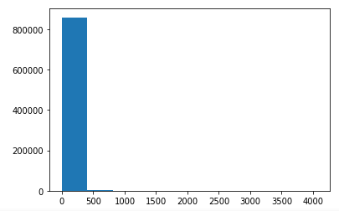
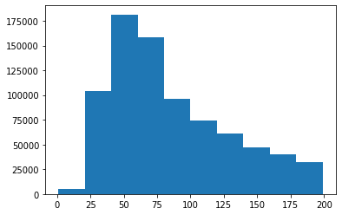
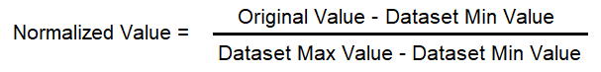

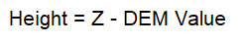
Preprocessing
Outliers removed – Intensity:
Data normalized
Height relative to ground extracted
R,G,B values from imagery extracted

Slide 7
Models/Algorithms
Random Forest Decision Tree
Used to classify ground
K-means clustering
Used to classify by height(Z) and intensity
DBSCAN spatial clustering
Classifies by spatial(X,Y) proximity

Slide 8
Performance Measures
Confusion Matrix and accuracy for supervised
Silhouette Score
Measure of cluster overlap
Between -1 and 1
Calinski-Harabsz Score
aka Variance Ratio Criterion
Ratio of distance of points within clusters to distance of cluster centres
Model Fit/Training Time
Cluster count and total points clustered

Slide 9
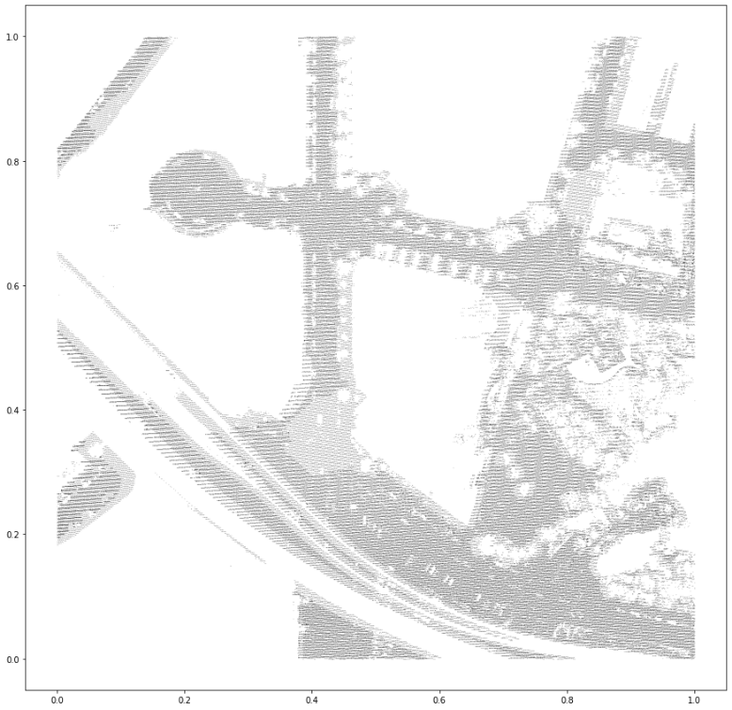
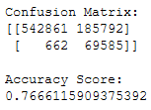
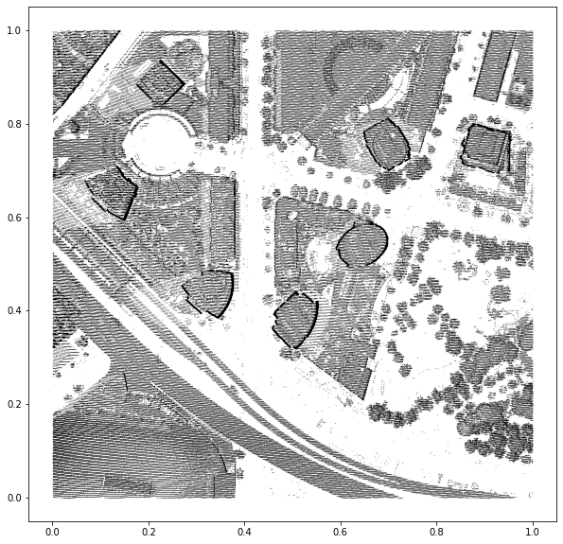
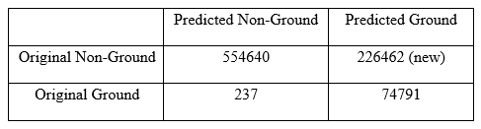
Random Forest: Ground (re)classification
Inputs:
Height
Intensity
Return Number Ratio
Labels:
Provided class 1 ground points
30s runtime
76% Accuracy

Slide 10
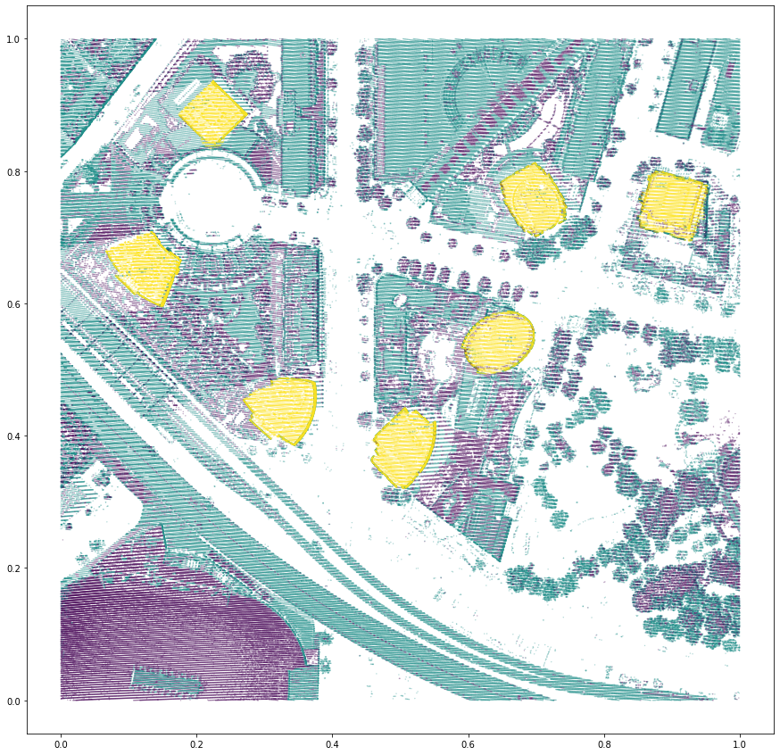
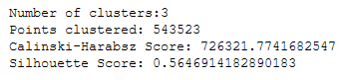
K-Means Clustering
Inputs:
Height
Intensity
Return Number Ratio
Parameters:
K=3
Determined by testing and maximizing performance scores
3s runtime
0.56 Silhouette Score

Slide 11
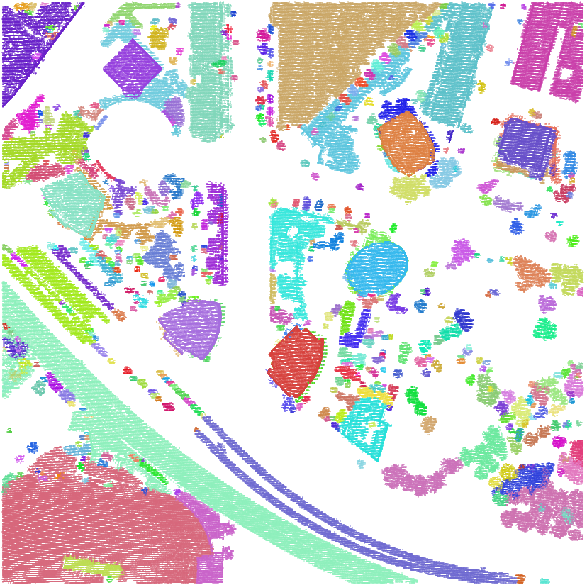
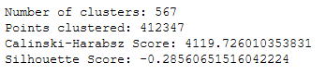
DBSCAN: Spatial Clustering
Inputs:
X
Y
K-means cluster id
Parameters:
‘eps’ = 0.005
Minimum distance between points
min_points = 50
Points required to make a cluster
5min runtime
-0.27 Silhouette Score

Slide 12
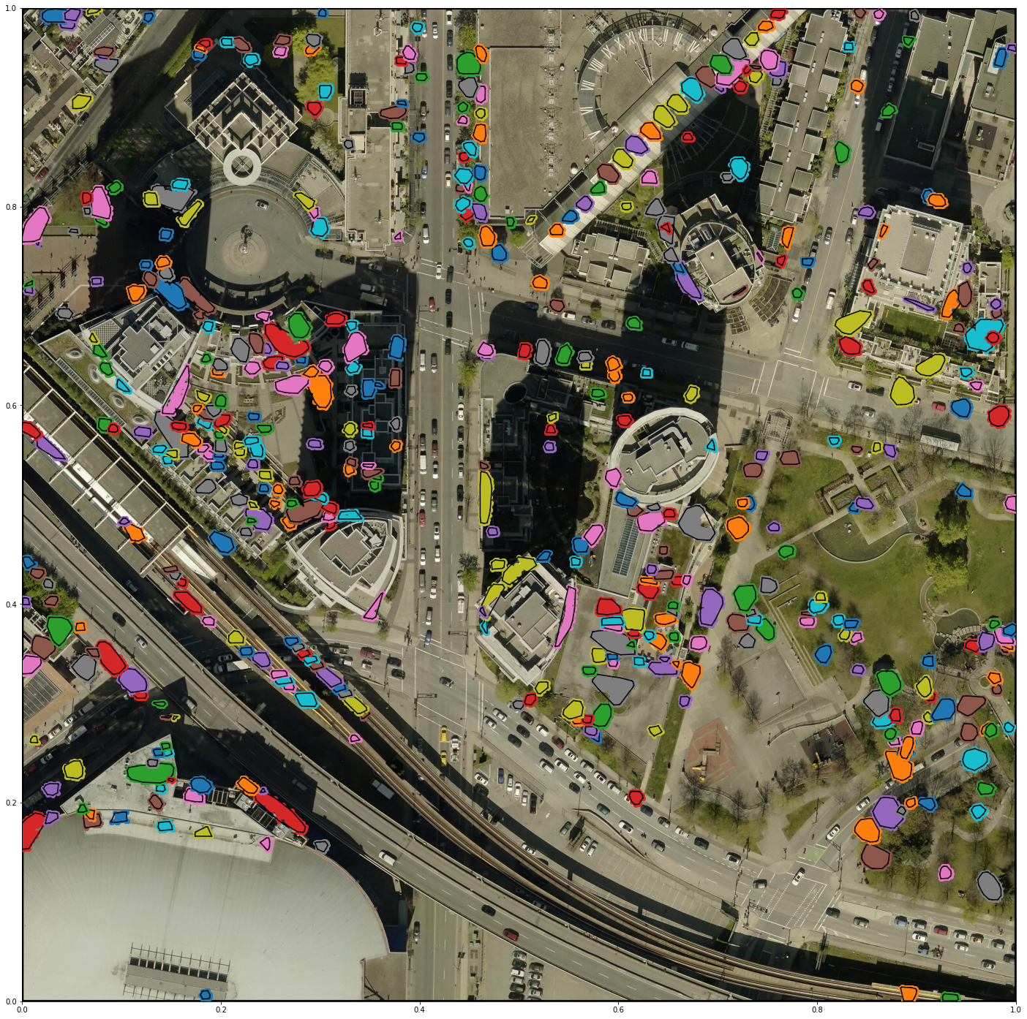
Small Clusters
Less than 500 points
489 features
Trees
Balconies
Window panes
Rooftop features

Slide 13
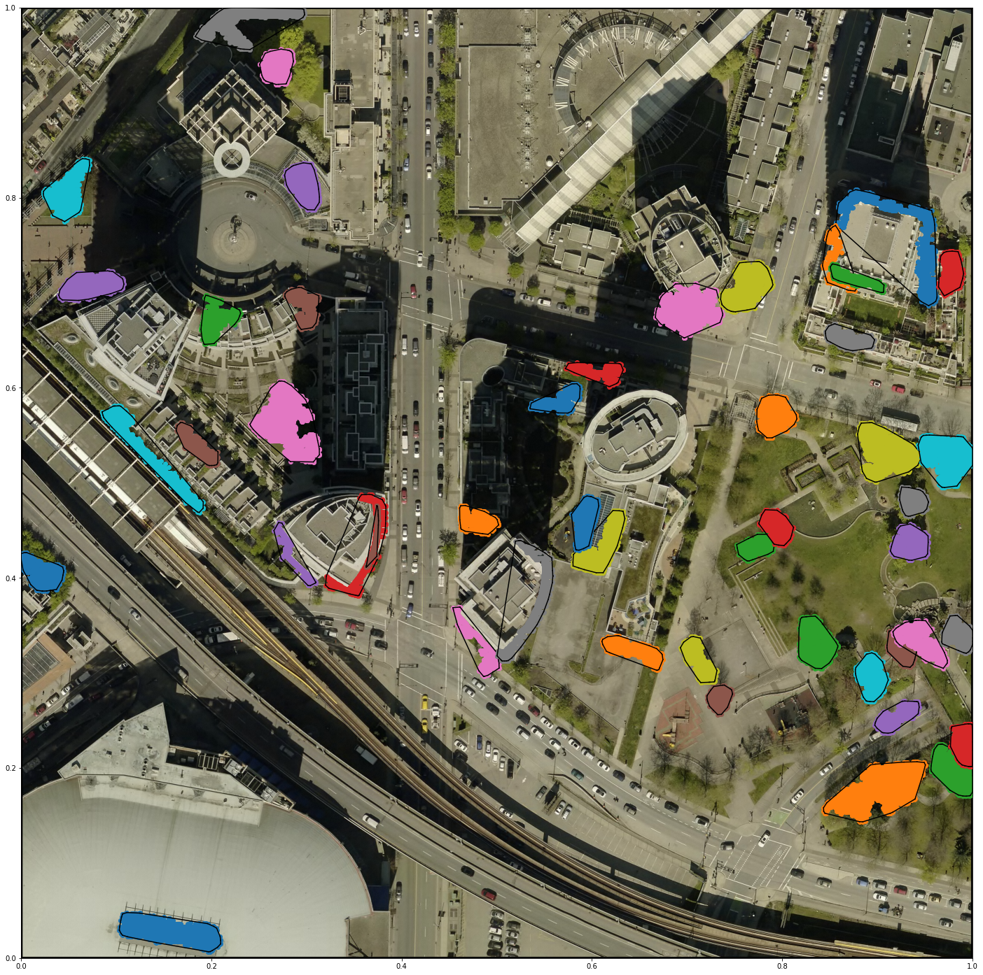
Medium Clusters
Between 500 and 2500 points
48 features
Large tree canopies (likely lower height)
Balconies

Slide 14
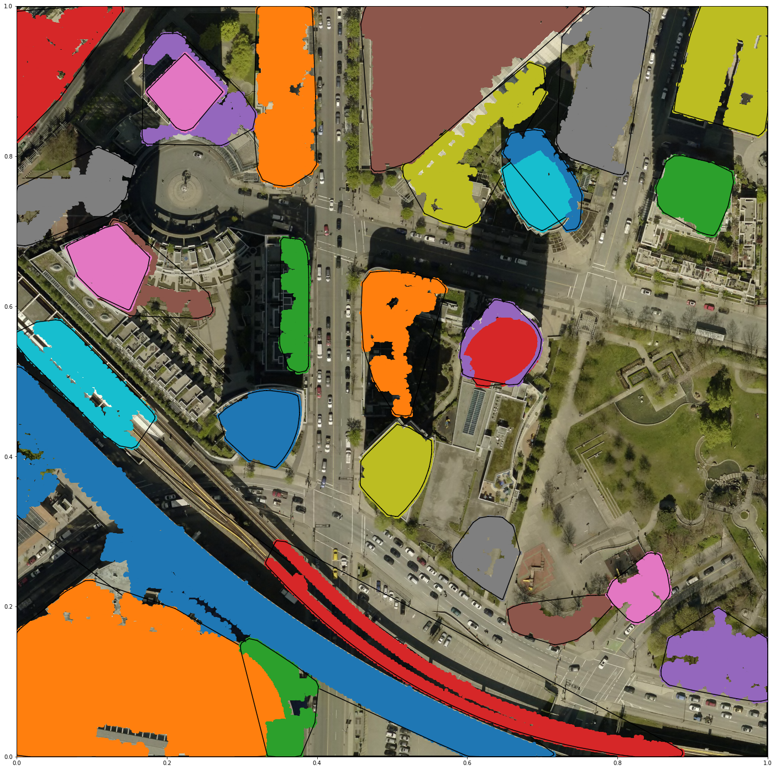
Large Clusters
Over 2500 points
29 features
Building footprints
Large canopies
Large Buildings
Raised roadway
Raised Railway

Slide 15


Slide 16
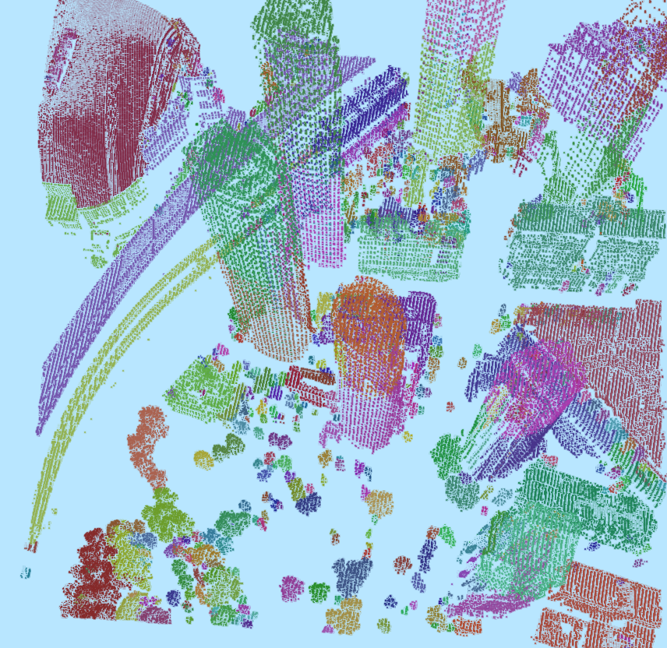

Slide 17
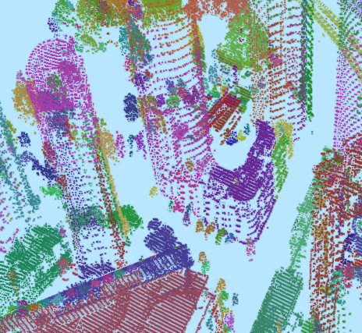

Slide 18
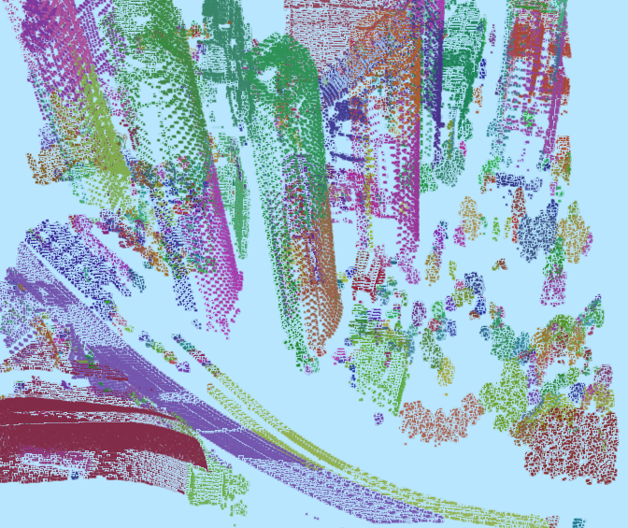

Slide 19
Summary/Conclusion
Research Question: “Can unique objects or features be distinguished from lidar point cloud data by using sci-kit learn clustering workflows?”
Project Goal was to identify unique objects by clustering LiDAR point cloud data
Original total of ~ 800,000 points
Random Forest classifier model identified ~226,000 additional ground points
K-means and DBSCAN clustering algorithms used to identify 567 unique proximally located clusters representing unique features or objects from ~410,000 total points clustered

Slide 20
Limitations
Better performance metrics needed to more objectively assess the performance of the unsupervised models
R,G,B values from imagery would have been useful had it not been for the presence of shadows
Better visualizations for 3d data needed
Next steps:
Classify the final results by object type
Run the model on additional datasets

Slide 21
Thank you.

Slide 22
References
Sklearn.ensemble.randomforestclassifier. scikit. (n.d.). Retrieved April 2, 2022, from https://scikit-learn.org/stable/modules/generated/sklearn.ensemble.RandomForestClassifier.html
Sklearn.cluster.KMeans. scikit. (n.d.). Retrieved April 2, 2022, from https://scikit-learn.org/stable/modules/generated/sklearn.cluster.KMeans.html
Sklearn.cluster.DBSCAN. scikit. (n.d.). Retrieved April 2, 2022, from https://scikit-learn.org/stable/modules/generated/sklearn.cluster.DBSCAN.html
Esrine Chehata, Li Guo, Clément Mallet. Airborne lidar feature selection for urban classification using random forests. Laserscanning, Paris, France. ffhal-02384719, Sep 2009
LI Yong, Wu Huayi. Adaptive building edge detection by combining lidar data and aerial images. The International Archives of the Photogrammetry, Remote Sensing and Spatial Information Sciences. Vol. XXXVII. Part B1. Beijing 2008
M. A. Dogon-Yaro, P. Kumara, A. Abdul Rahman, G. Buyuksalih. Semi-automated approach for mapping urban trees from integrated aerial lidar point cloud and digital imagery datasets. The International Archives of the Photogrammetry, Remote Sensing and Spatial Information Sciences, Volume XLII-4/W1, 2016
E. Özdemir, F. Remondino, A. Golkar. Aerial point cloud classification with deep learning and machine learning algorithms. The International Archives of the Photogrammetry, Remote Sensing and Spatial Information Sciences, Volume XLII-4/W18, 2019
D.L. Bool, L.C. Mabaquiao, M.E. Tupas, J.L. Fabila. Automated building detection using ransac from classified lidar point cloud data. The International Archives of the Photogrammetry, Remote Sensing and Spatial Information Sciences, Volume XLII-4/W9, 2018
Biswas Parajuli. Machine Learning Algorithms and Applications for Lidar, Images, and Unstructured Data. Florida State University Libraries, Electronic Theses, Treatises and Dissertations. 2019
Ming-Jer Huang, Shiahn-Wern Shyue, Liang-Hwei Lee, and Chih-Chung Kao. A Knowledge-based Approach to Urban Feature Classification Using Aerial Imagery with Lidar Data. Photogrammetric Engineering & Remote Sensing Vol. 74, No. 12, pp. 1473–1485, December 2008
Xuelian Meng, Nate Currit, Le Wang, and Xiaojun Yang. Detect Residential Buildings from Lidar and Aerial Photographs through Object-Oriented Land-Use Classification. Photogrammetric Engineering & Remote Sensing Vol. 78, No. 1, pp. 35–44, January 2012
Shane Grigsby. Spatial Clustering in Python: Processing LiDAR points into objects. University of California, Santa Barbara, NSERC
Florent Poux. Discover 3D Point Cloud Processing with Python. Towards Data Science. April 2020

